Slide 1


CST 238 – Enterprise Networking
Dean Polnerow

Slide 2

Outline
Network architecture
Domain Management
Database Management
Email
SharePoint
Virtual Machines
Migration
Web Server
Lessons learned
Questions

Slide 3
Introduction
ShoeRus.com
Kevin Rook
James Njangi
Pratik Patel
Glenn Strout

Slide 4
Network Architecture
Network Diagram
IP Addressing
Port Forwarding
NAT

Slide 5
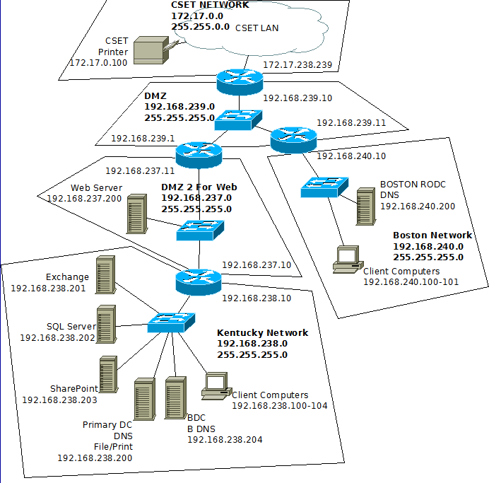
Network Diagram
Wireless
192.168.241.0

Slide 6
IP addressing
Only paying for one IP address
172.17.238.239
Kentucky Subnet
192.168.237.0
Boston Subnet
192.168.240.0
DMZ subnet
192.168.239.0
Web server subnet
192.168.237.0
Wireless Network
192.168.241.0

Slide 7
NAT
Network Address Translation is used on the router connected to the outside network(CSET LAN)
This allows computers within the company network to access outside resources like the internet.

Slide 8
Port Forwarding
Using NAT Port forwarding
Allows outside HTTP requests on port 80 to be sent to the web server.
No other ports have been forwarded for security purposes

Slide 9
Domain Management
Microsoft Active Directory
Kentucky
Primary Domain Controller
Backup Domain Controller
Boston
Read-Only Domain Controller

Slide 10
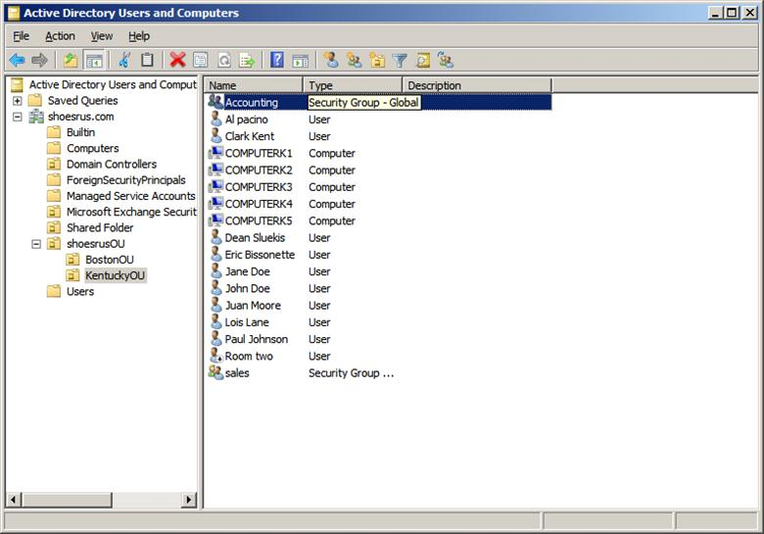
Users/computers
Users split between Boston and Kentucky
5 computers in Kentucky
2 computers in Boston

Slide 11
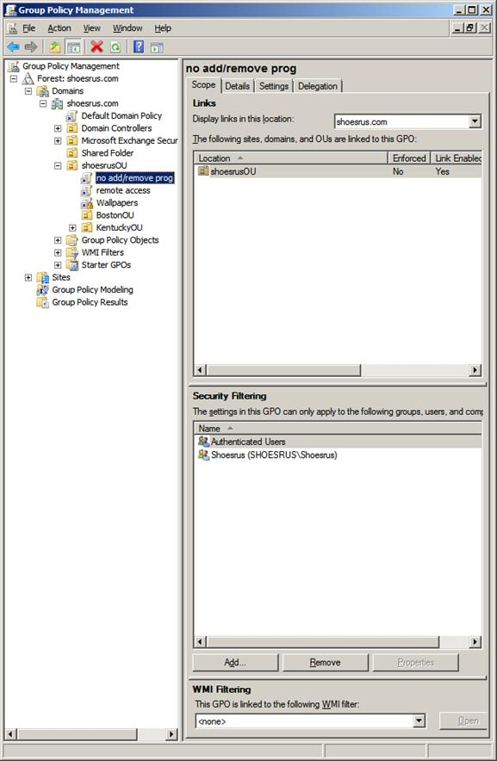
groups and group policy's
Groups for accounting, management, shoesRus, warehouse and others.
Group policies limited uses access

Slide 12
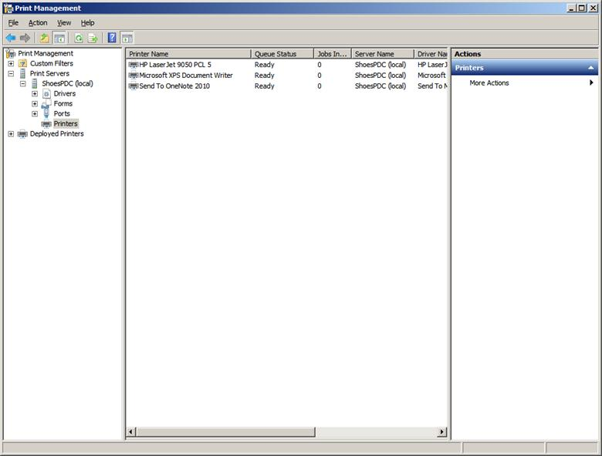
Printer
Shared printer for admins and users.
Boston can print a paper in Kentucky

Slide 13
Database Management
Microsoft SQL Server 2010
CREATE, MANAGE, MANIPULATE DATABASE
RETRIEVE DATA FROM DATABASE
UPDATE RECORDS IN DATABASE
IT CAN CREATE NEW TABLE IN DATABASE

Slide 14
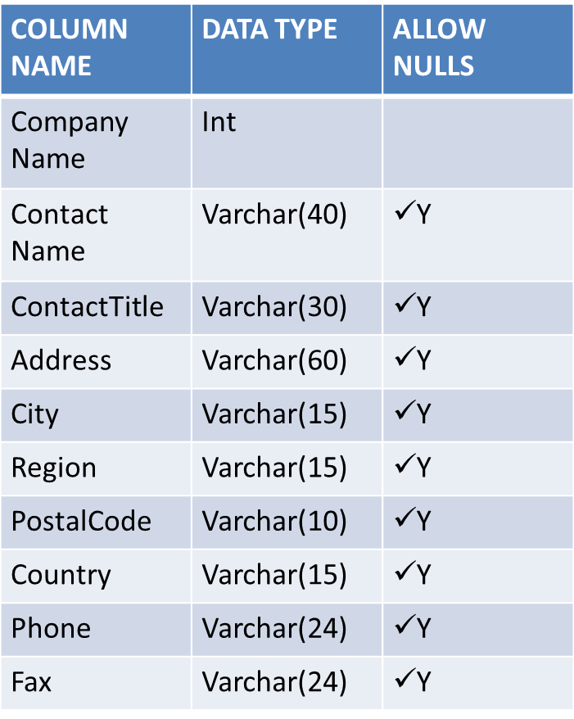
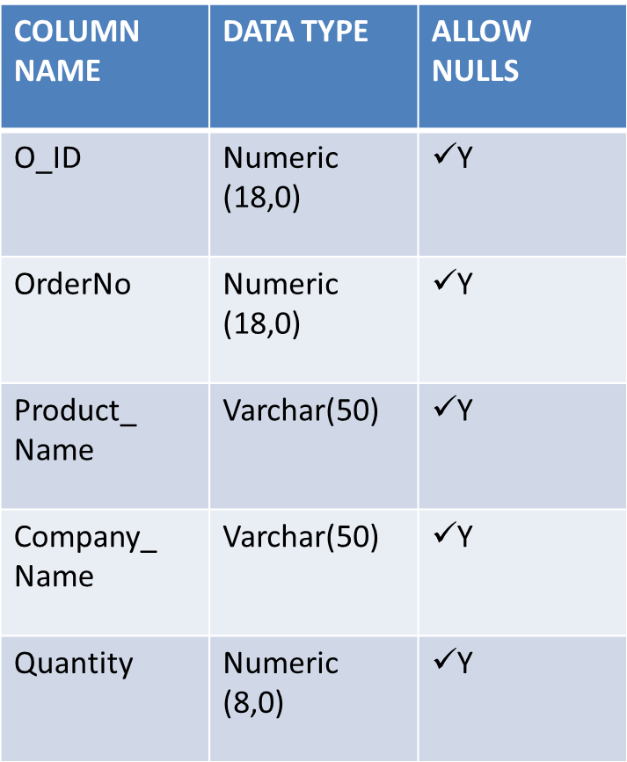
Tables
Customers Table
Order Table

Slide 15
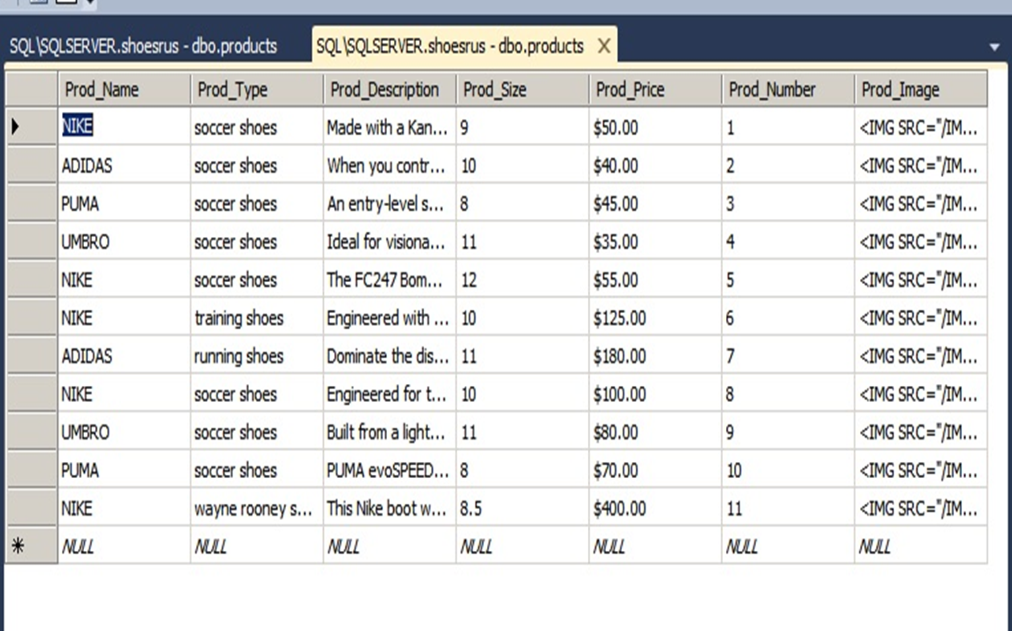
Product Table Columns

Slide 16
Images:
<IMG SRC=“/IMAGES/NIKE1.JPG”>
Image path or name to database
Store images to the location where your application has access
Use VARCHAR data type in the table
Save just the image name in the DB.
The rest of the path can be stored in a global variable defined in the web.config file.

Slide 17
USING SQL IN WEBSITE
Accessing SQL Server Database with PHP
It allows PHP developer to access to Database
3 TYPES TO BACKUP DATABASE
Full
Partial
Differential

Slide 18
Email
Microsoft Exchange 2010
Each user has their own mailbox which can be accessed by Microsoft Outlook or Outlook Web App

Slide 19
Email Cont.
Room mailbox
Setup to receive requests for the conference room located in Kentucky.
Users send email to room mailbox to request the room
Room will reply back with either a success, or failure, and give a reason for the failure

Slide 20
SharePoint
What is SharePoint
Functionalities - Manage information - Share files -Collaborate
How we use it in the company

Slide 21
Virtual Machine
What is a virtual machine
Why we are using Virtual machines
Installing and managing our virtual machines using - Hyper-V manager - MSC Virtual Machine Manager
Migration - Offline migration - Live migration

Slide 22
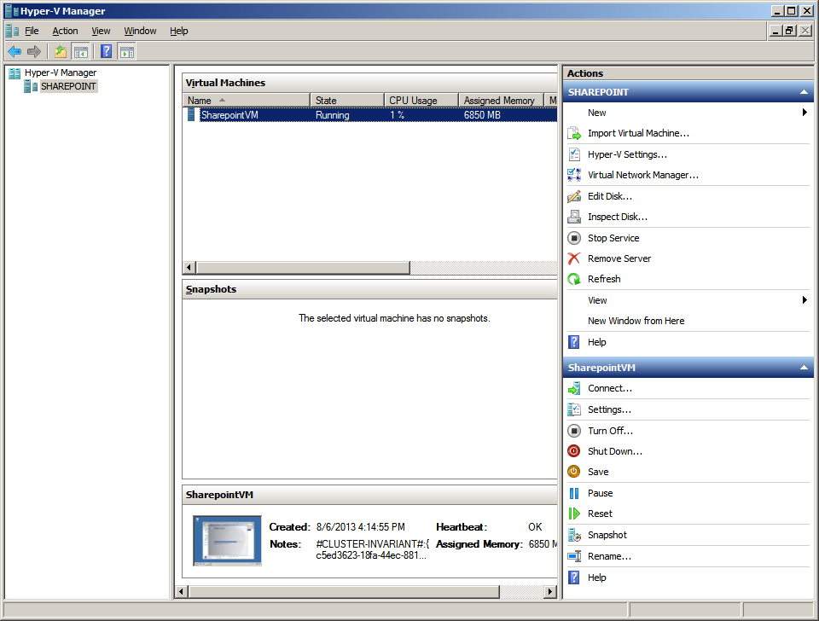
Hyper-V Manager

Slide 23
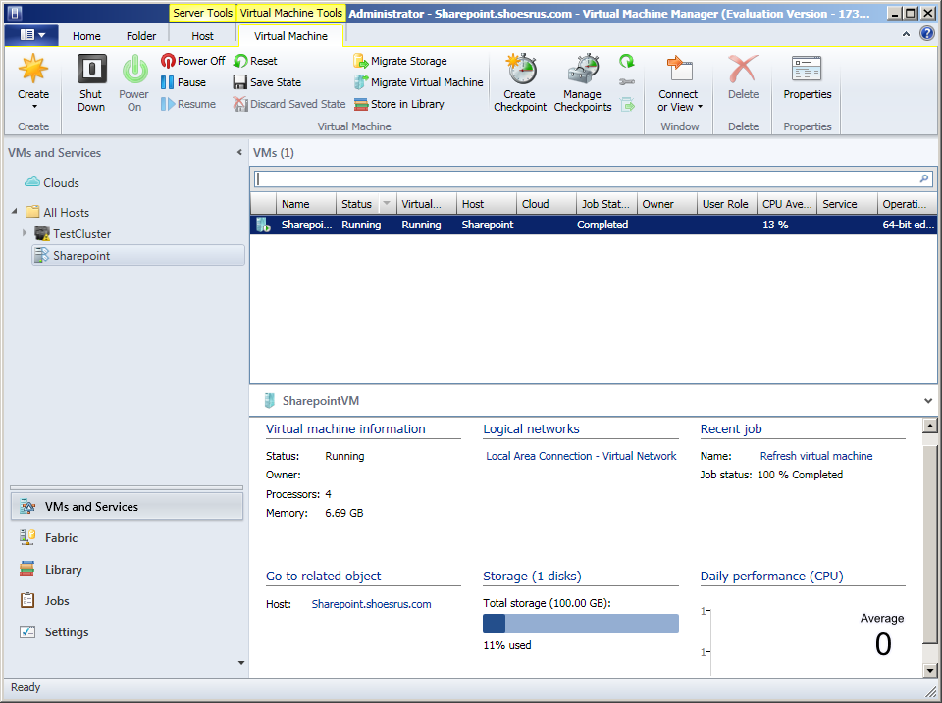
MSC VMM

Slide 24
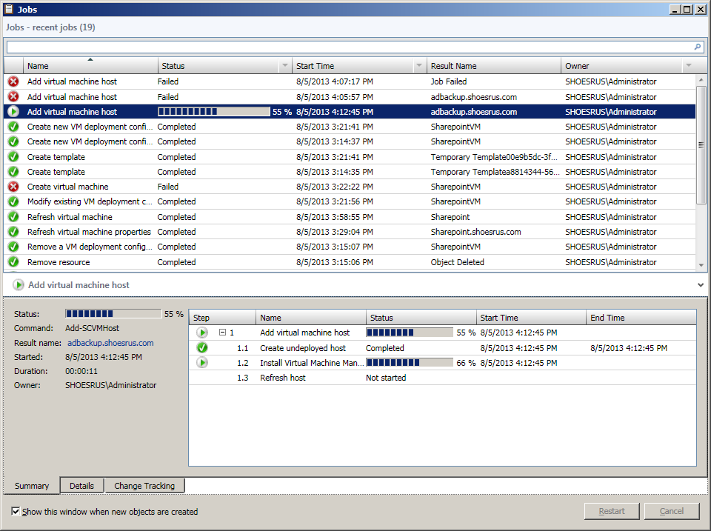

Slide 25
Web Server
Microsoft IIS (Internet Information Services)
Uses HTML/CSS for main script
PHP/SQL commands to connect to the SQL Server Database to get information on the shopping page
Virtual Directory to cover the Chrome/Firefox users.
Can be accessed by the CSET LAN by using IP address of 172.17.238.239

Slide 26
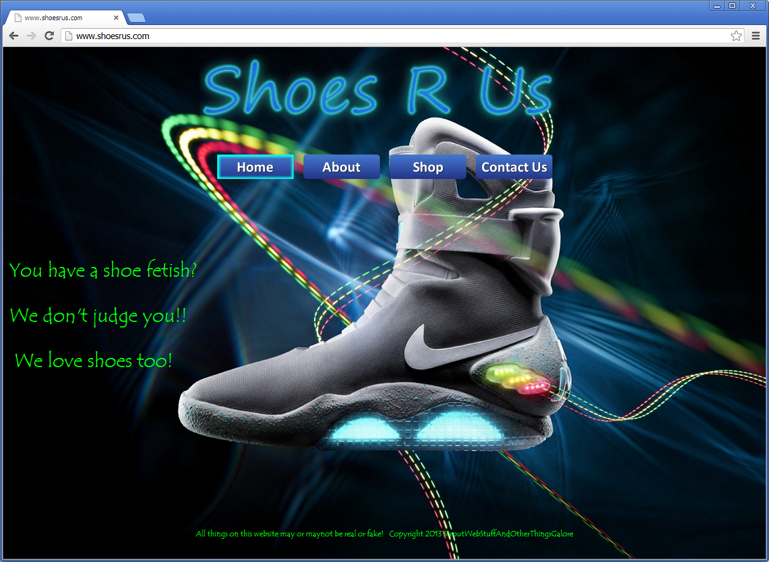
Home Page

Slide 27
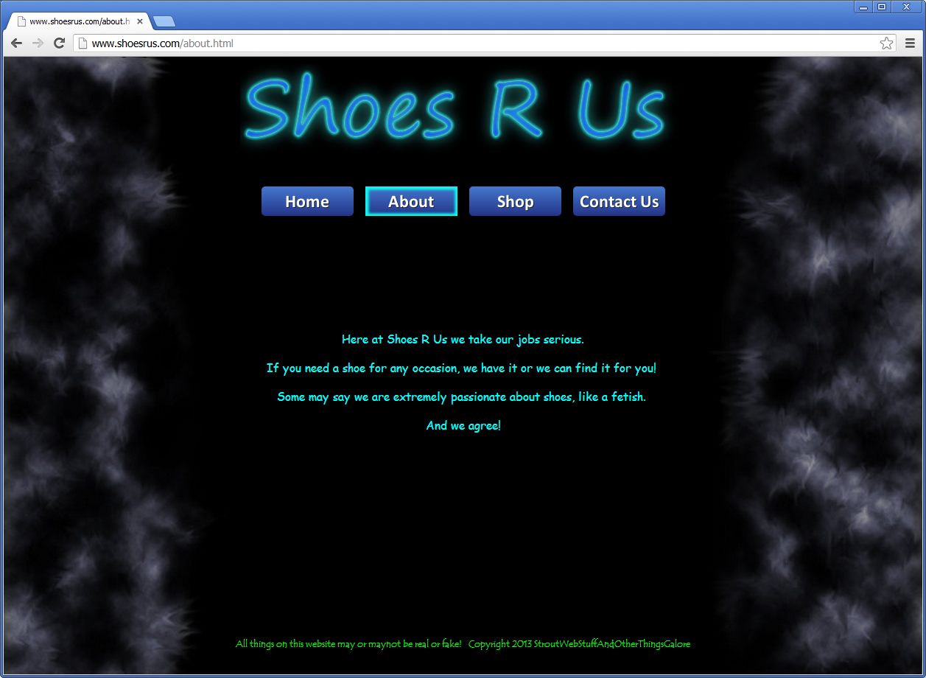
About

Slide 28
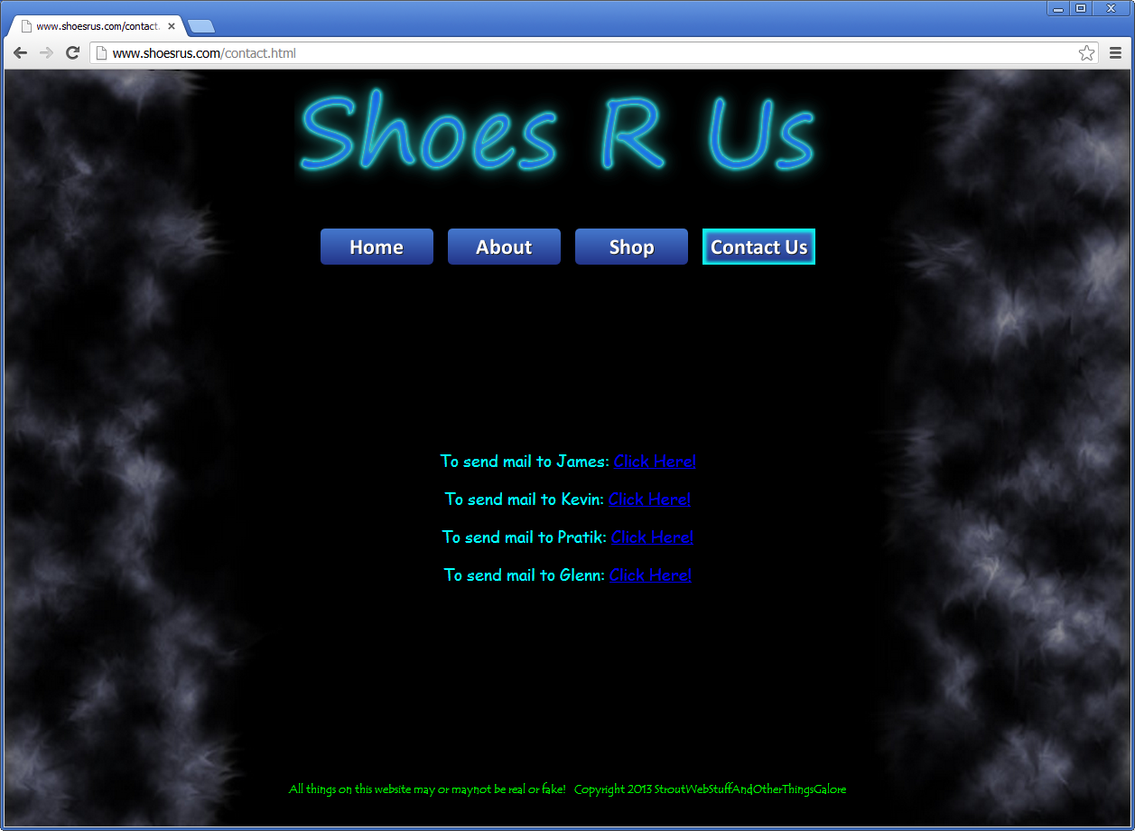
Contact us

Slide 29
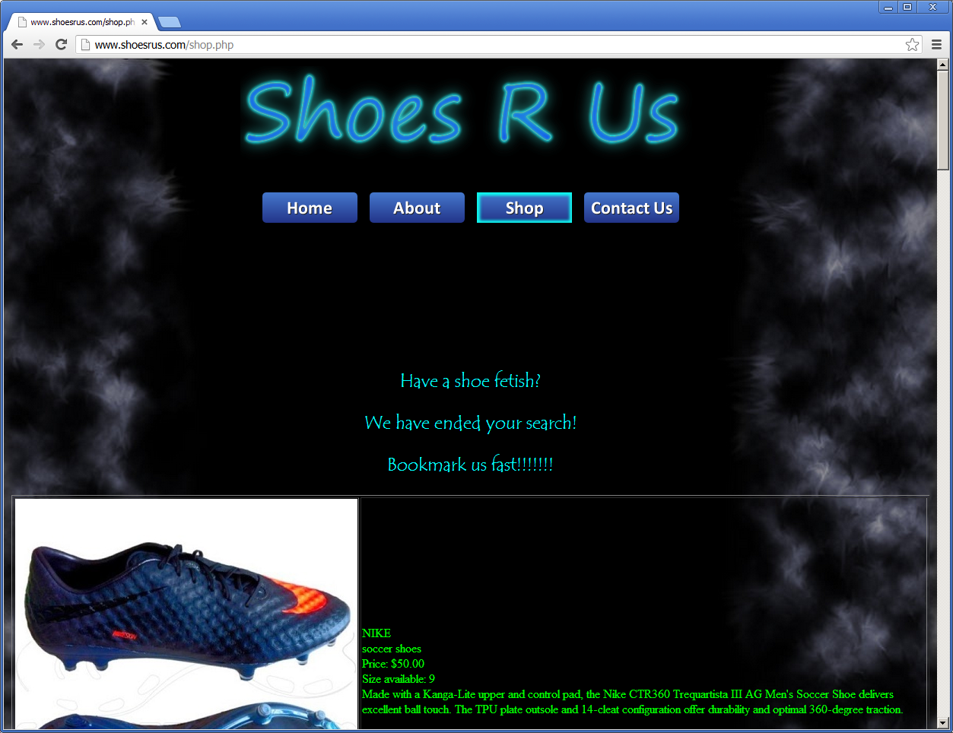
Shopping

Slide 30
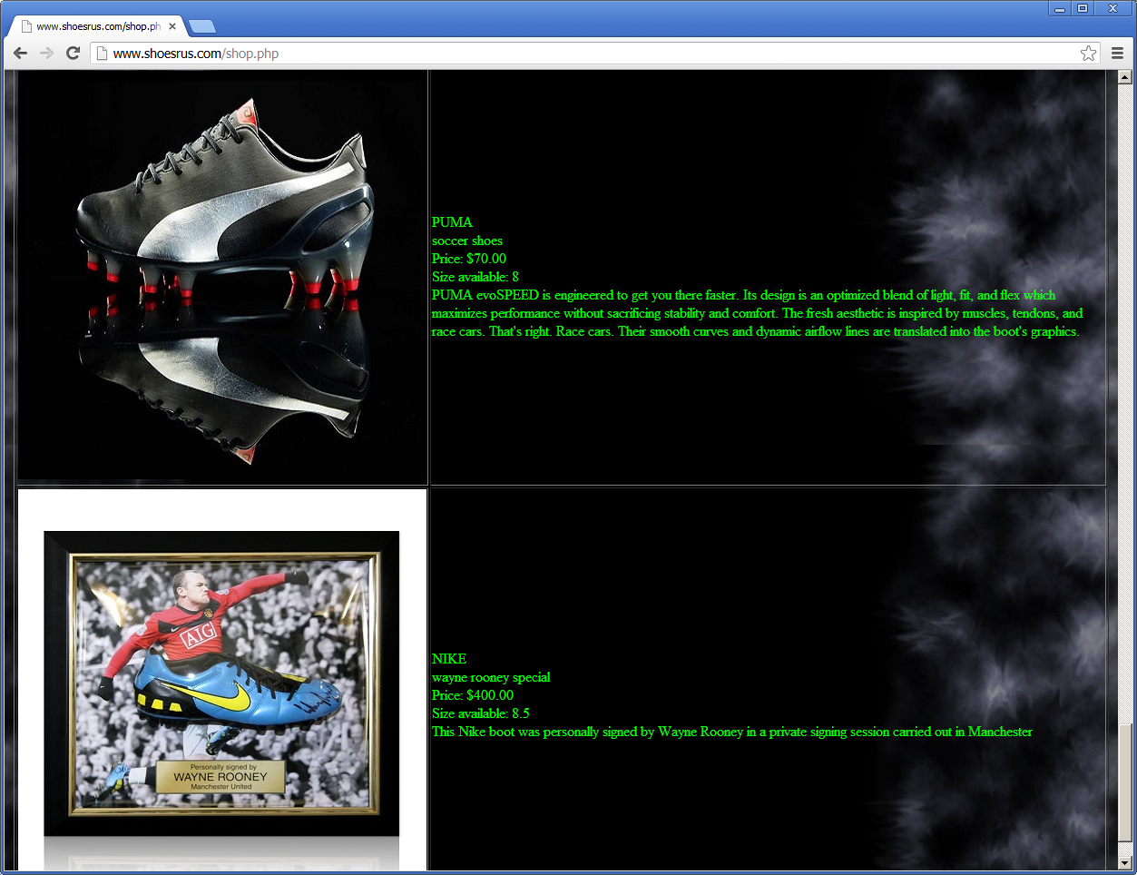
Shopping Cont.

Slide 31
Lessons Learned
www.shoerus.com as Domain name!!!!
Re-installed AD. Had to re-install one client.
Blue Screen (Room Mailbox)
Room Mailbox caused blue screen
Live Migration
Need an external storage server like a NAS or SAN
Virtualization
IP addressing (used 172.17.x.x)
Had to change to a different subnet like 192.168.x.x
NAT
1st configuration was not suitable for NAT
Chrome not showing pictures from database
Added a Virtual Directory to IIS
SQL authentication
Figure out how to connect to the database
Started out with hubs instead of switches
The equipment giving to us was wrong
Employee quit on us

Slide 32

Questions

